Slide 1
PPS MINI PROJECT
BANK MANAGEMENT SYSTEM

Slide 2
ABOUT US
ISHAAN MANHAS (RA2111027010031)
RAHUL NAIR (RA2111027010009)

Slide 3

DESCRIPTION
Bank Management System is based on dot NET.
It is used to keep the records of clients, employee etc in the bank.
The bank management system is an application for maintaining the customers personal information within the account of the bank .
The system provides the access to the customer to:-
create an account
deposit/withdraw the cash from his account
to view reports of all accounts present.
The following presentation provides the specification for the system.

Slide 4
ALGORITHM
Start.
Declare a structure name customer which includes variables account number, name, balance.
Declare the user defined functions such as display, accept, search, deposit, withdraw.
Declare variable, n, choice, account _no, amount index.
Use a do loop to display the list and use a switch case to collect input.
Display the declared result using functions.
Stop.

Slide 5
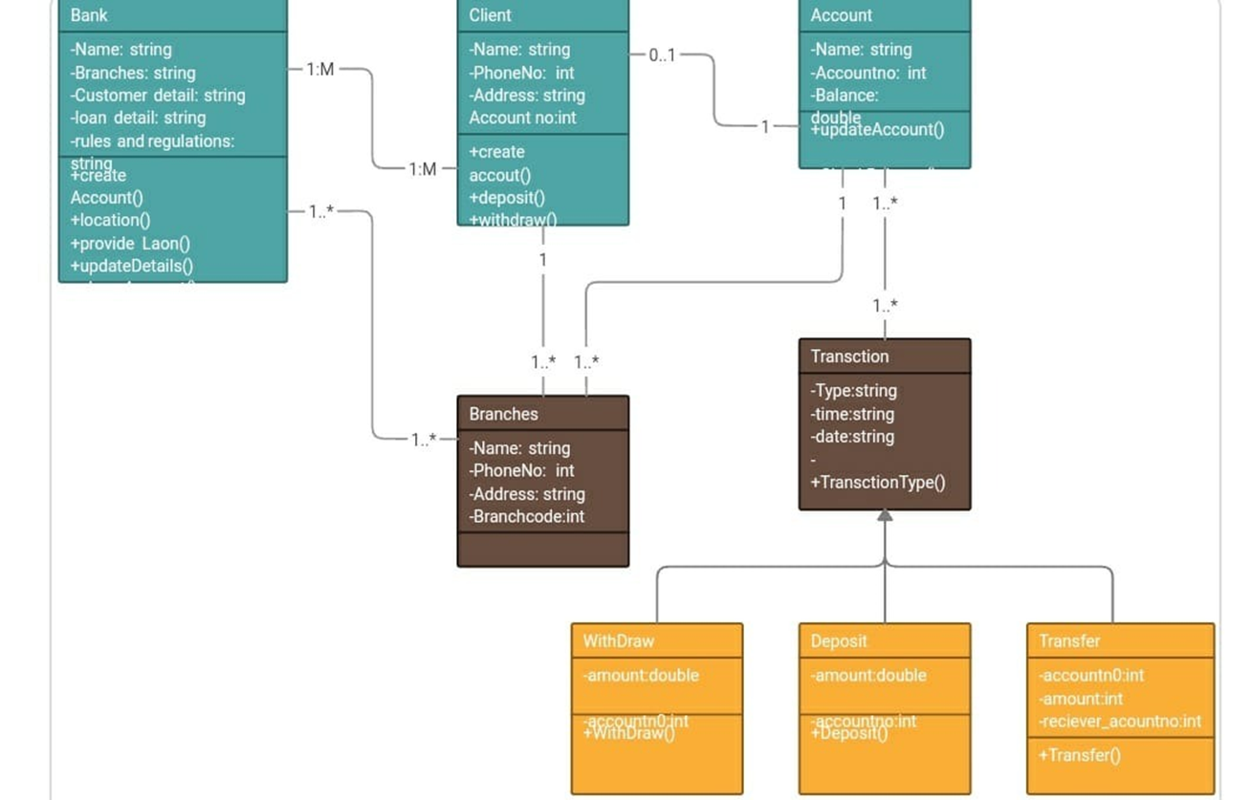
FLOWCHART

Slide 6

THE CODE

Slide 7
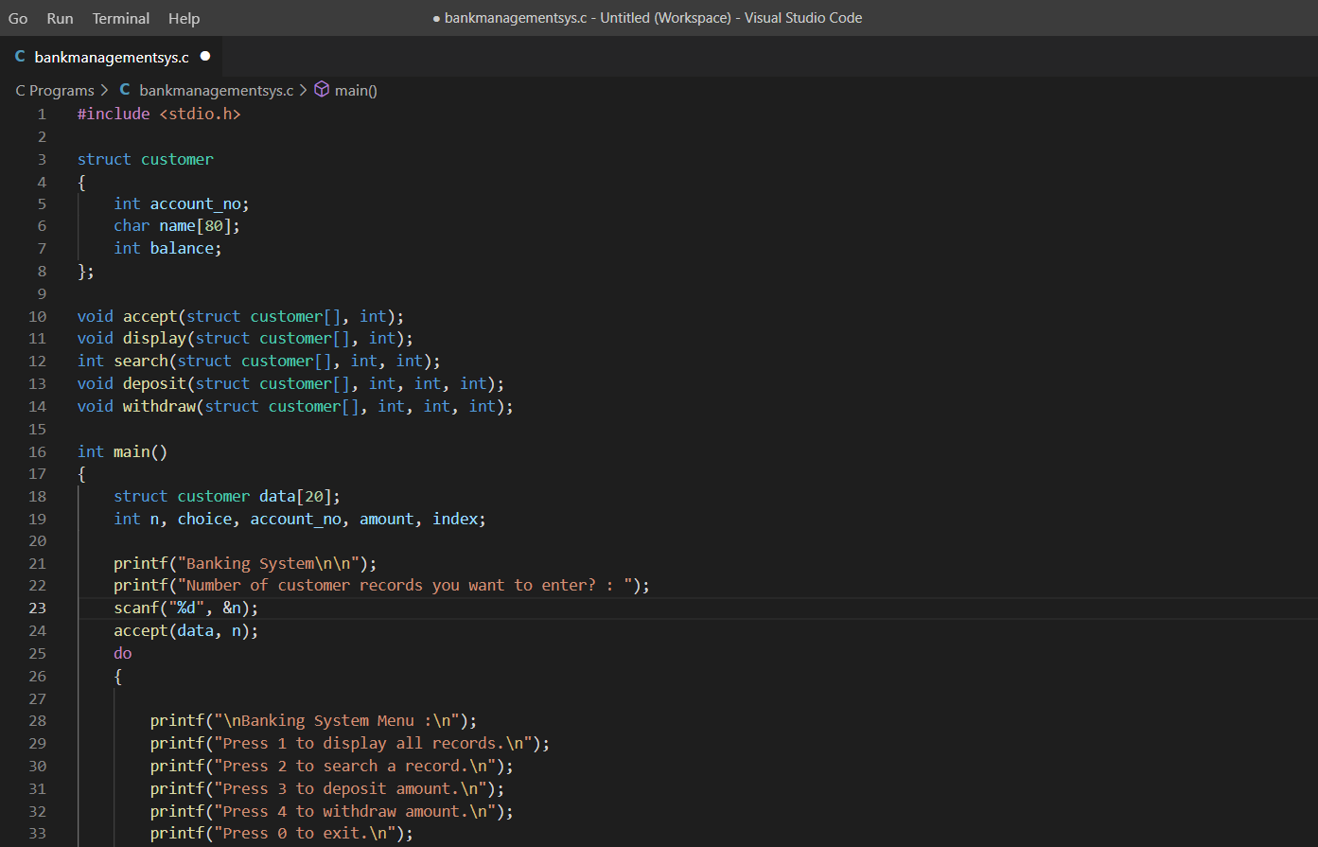

Slide 8
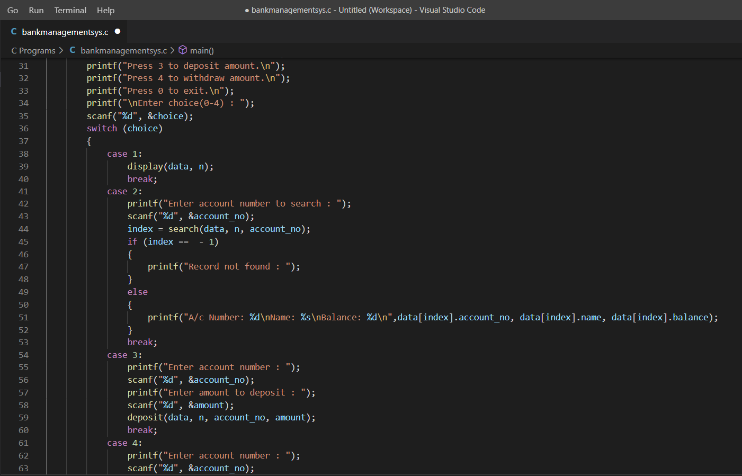

Slide 9
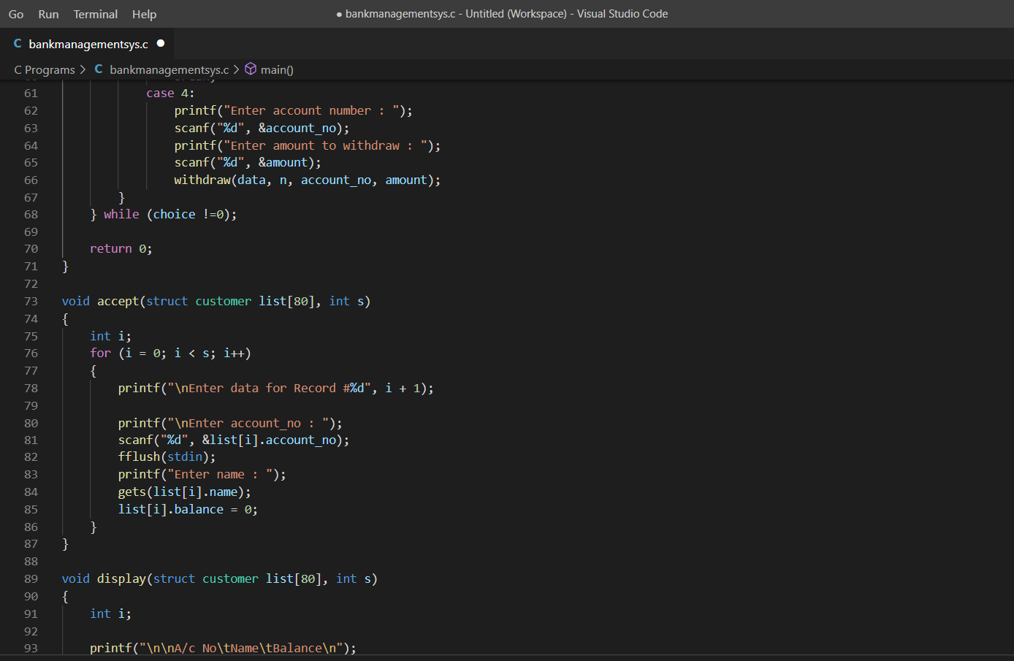

Slide 10
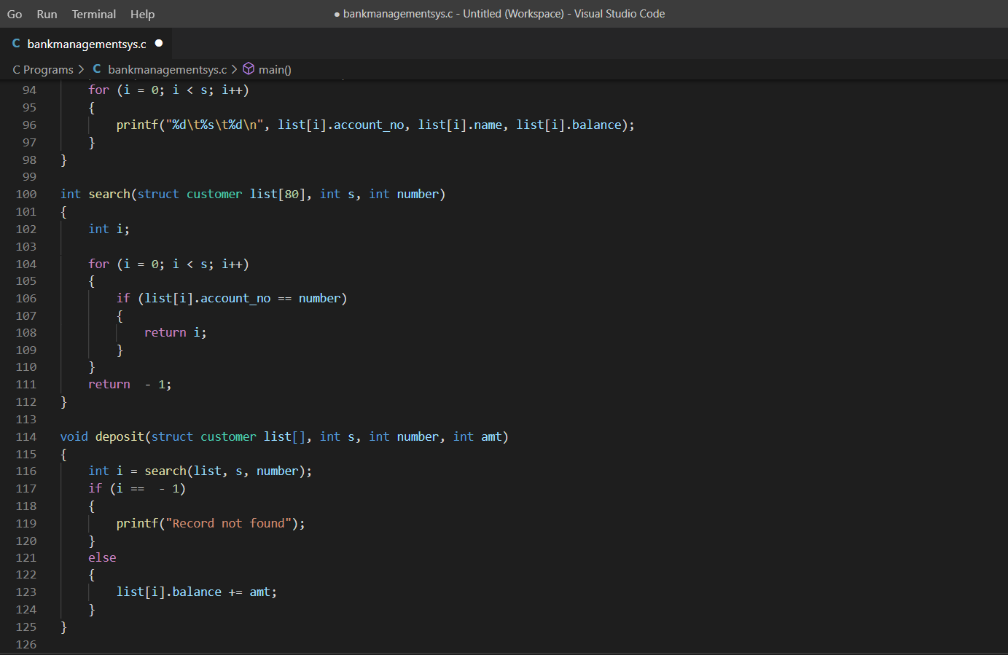

Slide 11

OUTPUT

Slide 12
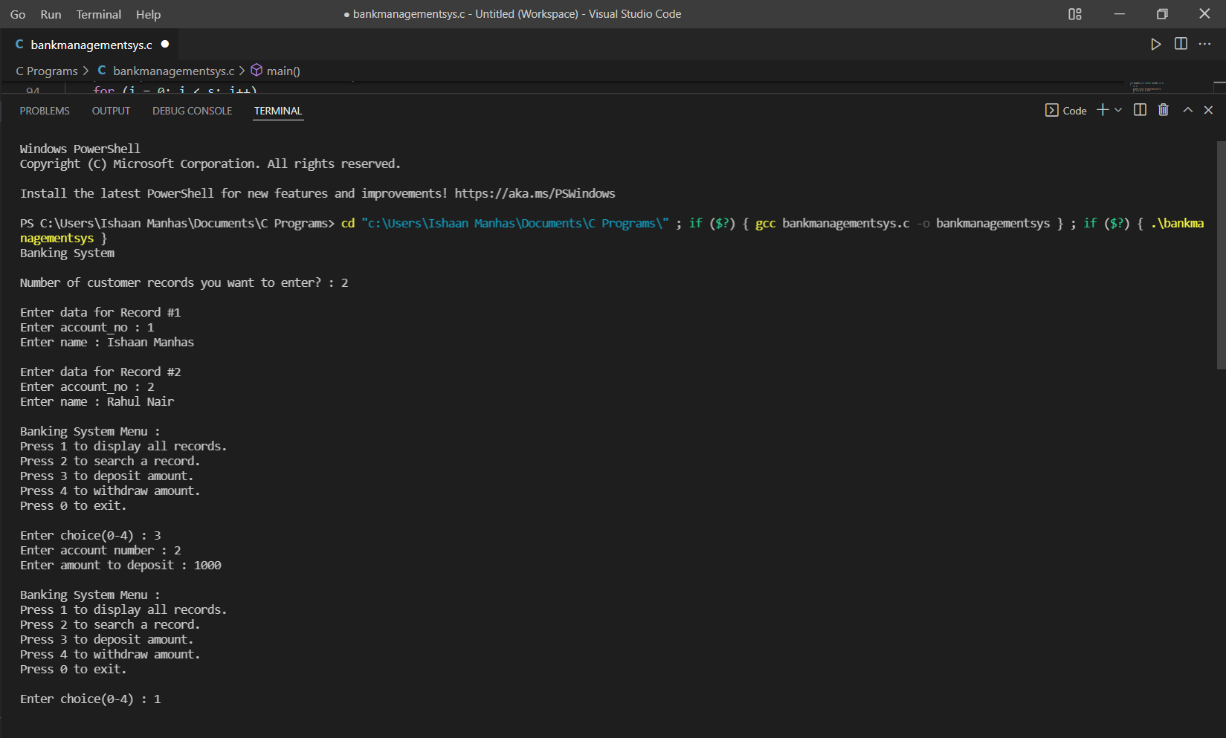

Slide 13
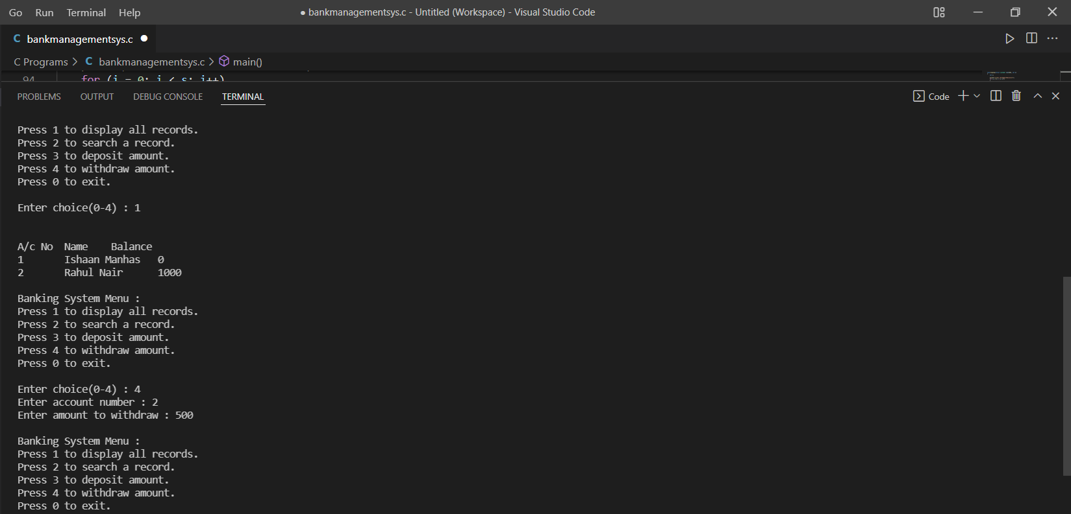

Slide 14
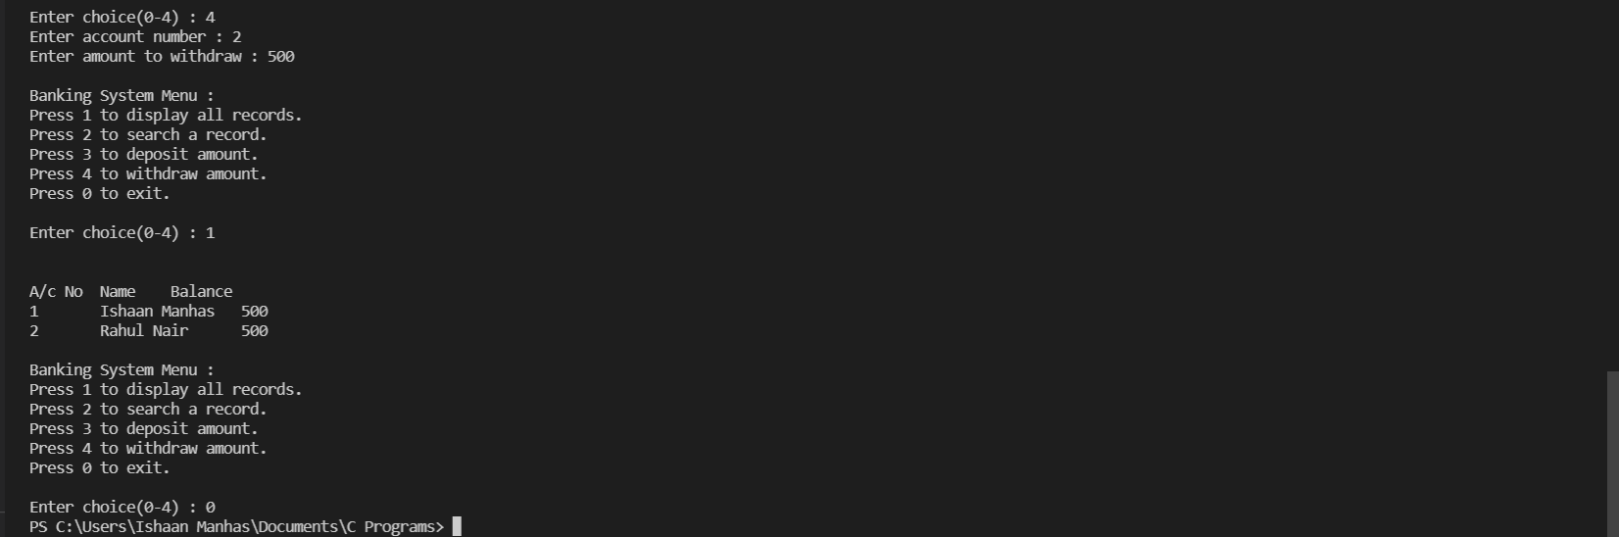

Slide 15

THANK YOU

